Slide 1
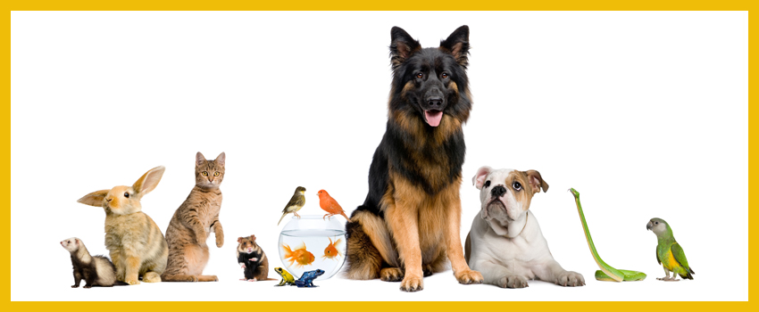
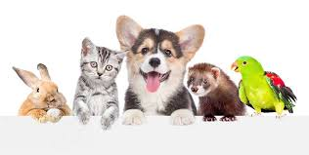
MY PETS
https://www.youtube.com/watch?v=pWepfJ-8XU0&ab_channel=SuperSimpleSongs-KidsSongs

Slide 2
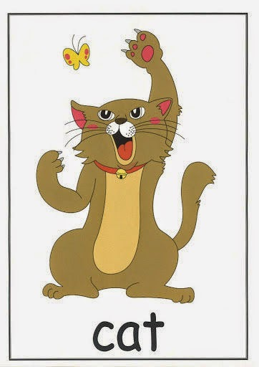

Slide 3
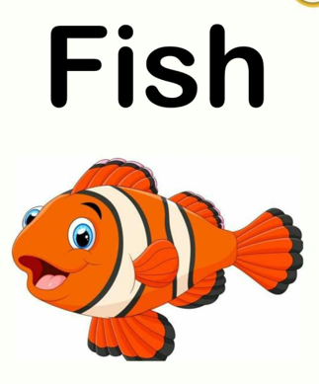

Slide 4
