Slide 2
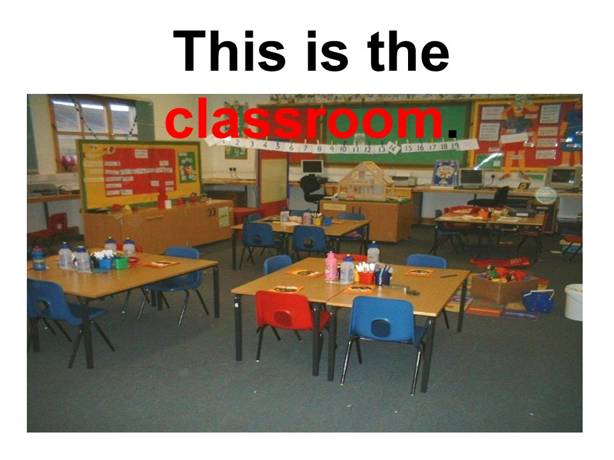

Slide 3
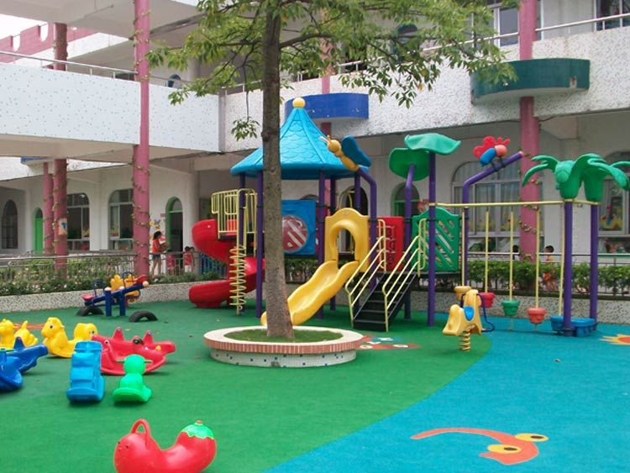

Slide 4
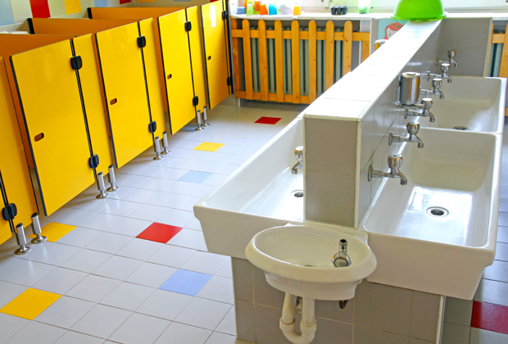

Slide 5
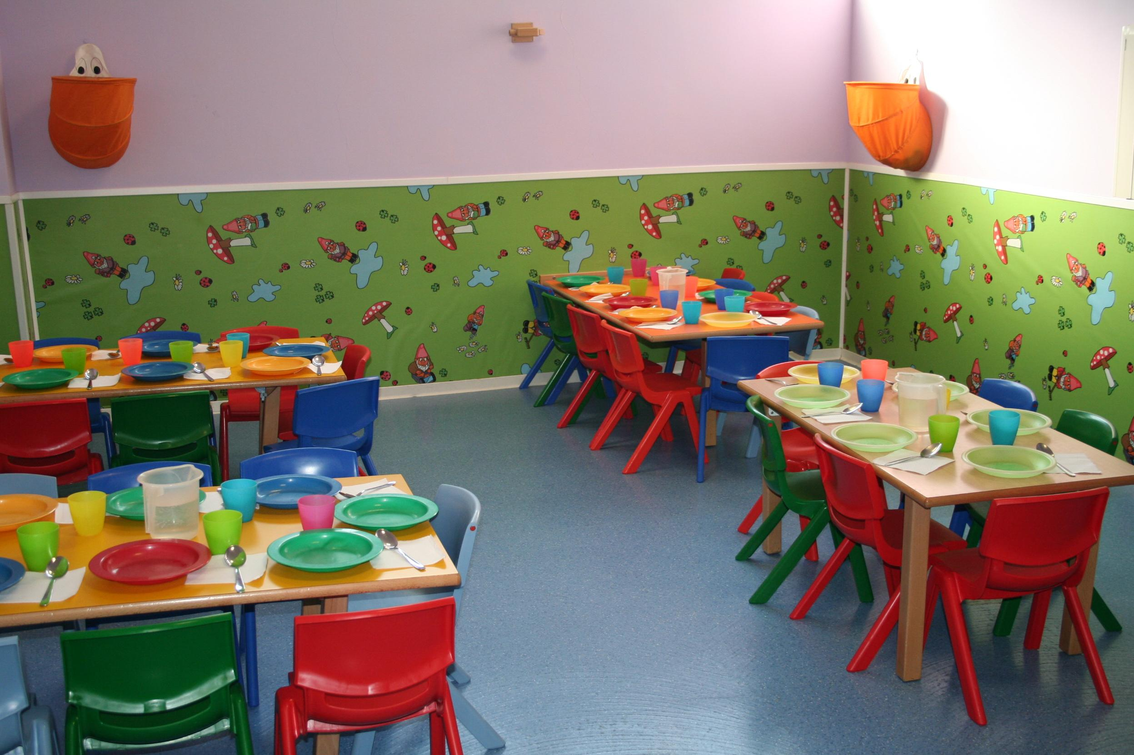

Slide 6
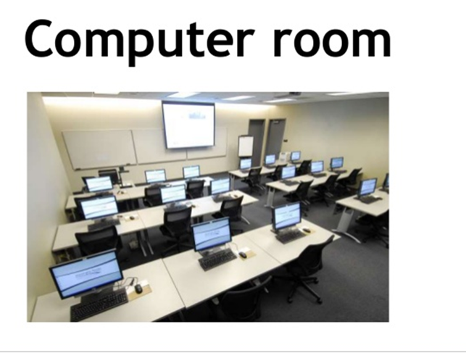
https://www.youtube.com/watch?v=2i4CbCINjWA
https://www.youtube.com/watch?v=QTpEGh_DM5I

