Slide 1
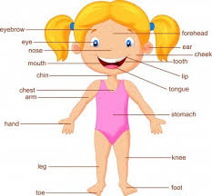
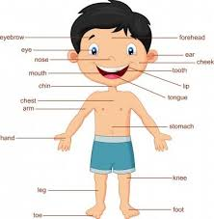
MY BODY
Https://www.youtube.com/watch?v=SUt8q0EKbms
https://www.youtube.com/watch?v=QkHQ0CYwjaI

Slide 2
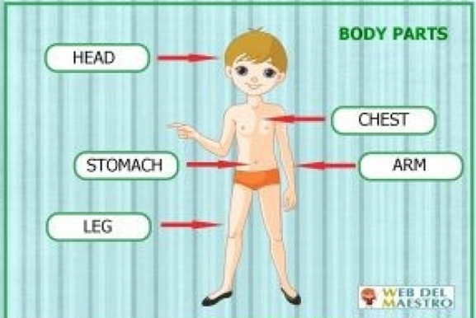

Slide 3
