Slide 1
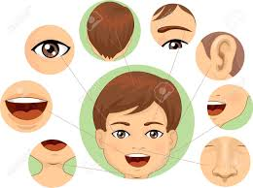
MY FACE
https://www.youtube.com/watch?v=lU4MHsiOA60
https://www.youtube.com/watch?v=3SjyEPhc-Tk

Slide 2
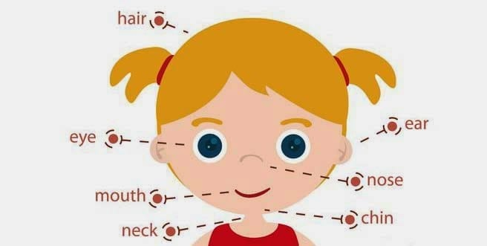

Slide 3
