Slide 1
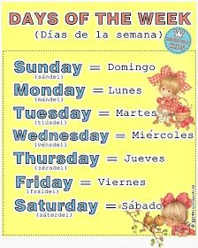
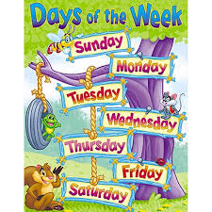
WHAT DAY IS TODAY? THE DAYS OF THE WEEK.

Slide 4
https://www.youtube.com/watch?v=mXMofxtDPUQ

