Slide 1



MY HOUSE
ROOMS

Slide 2
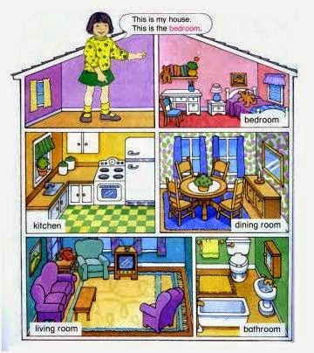

Slide 3




Slide 4
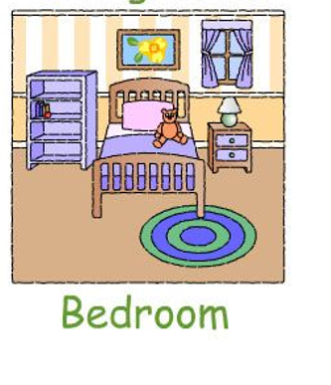

https://www.youtube.com/watch?v=Hhj0LQ_8loI
https://www.youtube.com/watch?v=nfBsIA5Lr0U

