Slide 1


MY FAMILY
hthttps://www.youtube.com/watch?v=FjrxzX-24KEtps://www.youtube.com/watch?v=u9kpdmCtO34

Slide 2
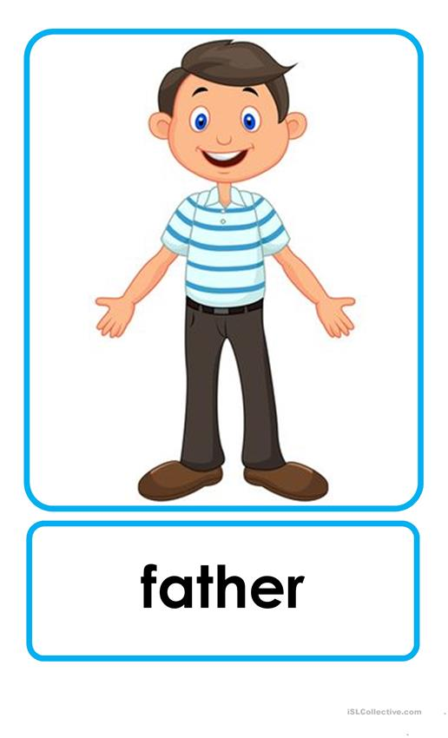
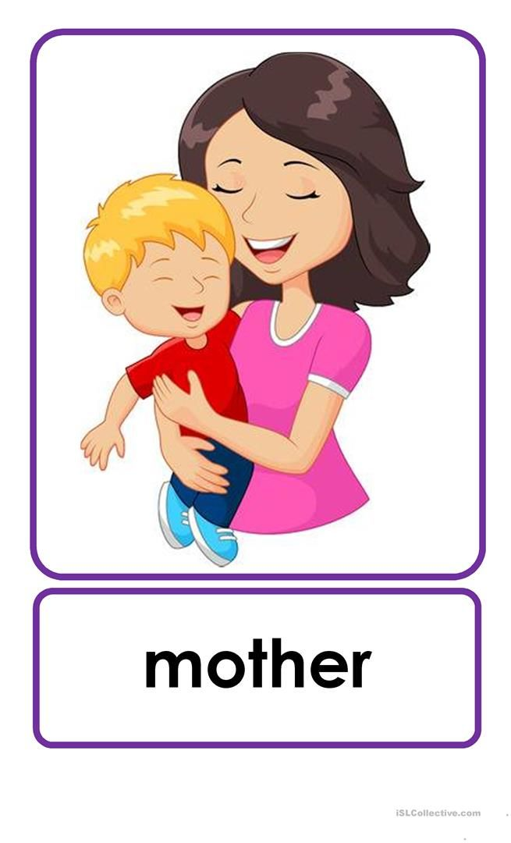
DAD MUM

Slide 3
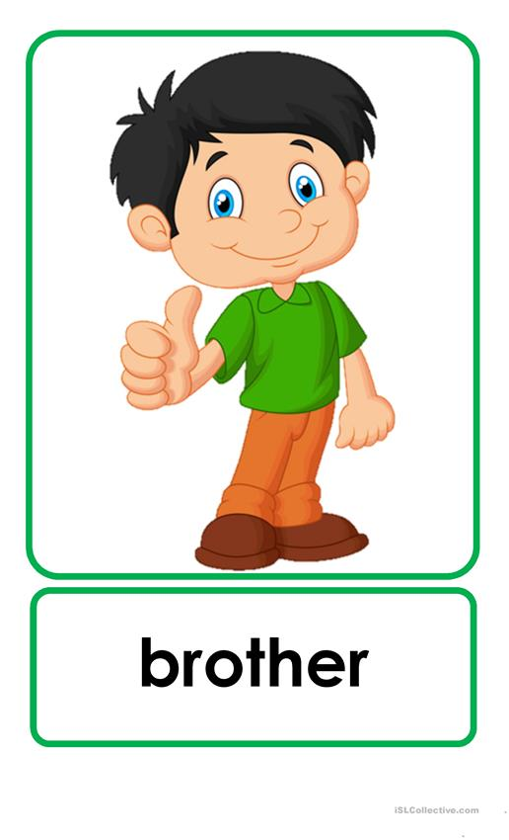



Slide 4
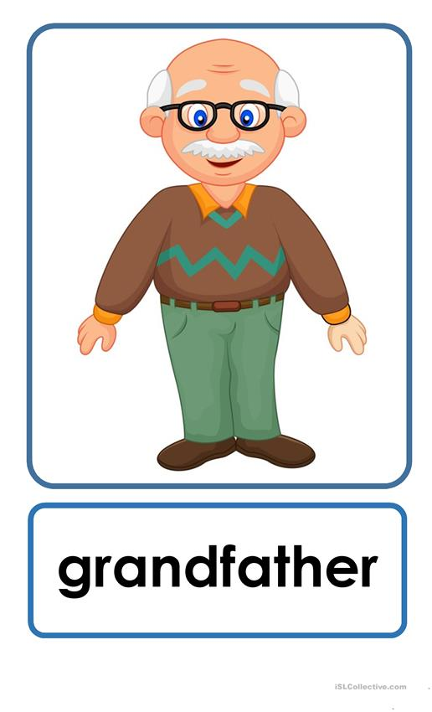
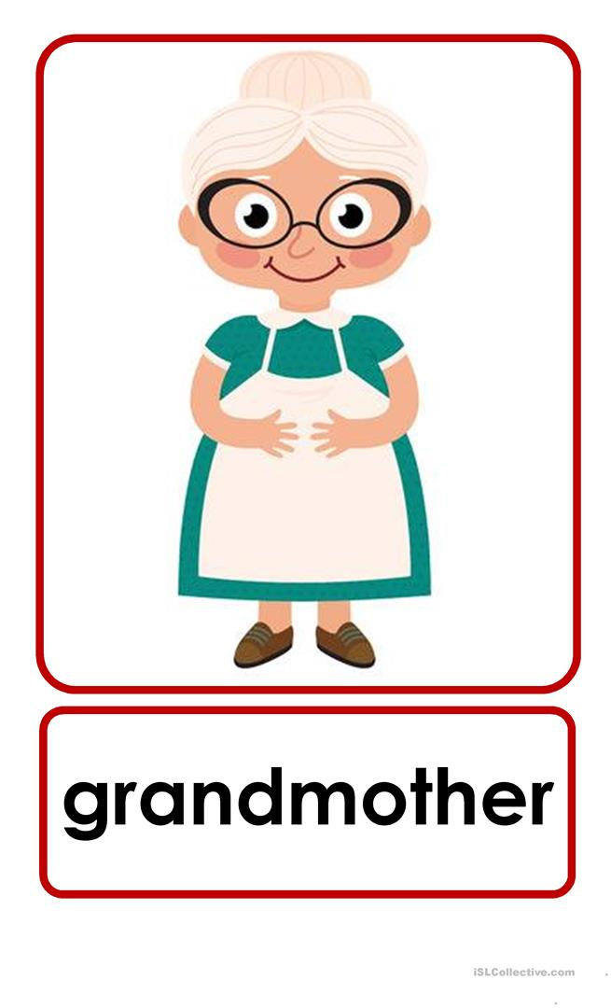
GRANDPA GRANDMA

Slide 5


