Slide 1
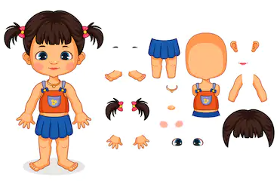
MY BODY
https://www.youtube.com/watch?v=QkHQ0CYwjaI

Slide 2
