Slide 1


UNIT2: COUNTRIES,CULTURES AND CUSTOMS
Grade: 8th
Miss Pamela Knuckey

Slide 2


Feedback about last class…
Cómo es la estructura gramatical de una comparación?
Qué parte de la oración se usa para hacer una comparación?
Para qué me sirve “er” cuando hablamos de comparatives?

Slide 3
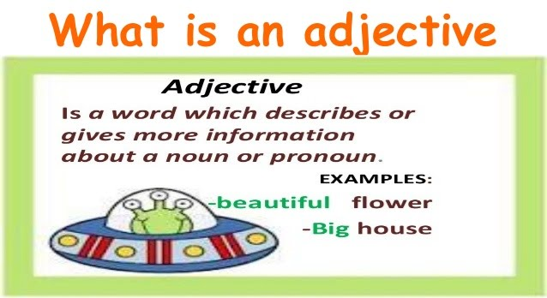
Today we are going to see.. adjectives
Qué es un adjetivo calificativo?

Slide 4

Vocabulary
1- small
2- big
3- beautiful
4- powerful
5- comfortable
6- lovely
7- interesting
8- bad
9- good
10- happy

Slide 5
Vocabulary
11- cold
12- hot
13- expensive
14-honest
15-popular
16- large
17-dangerous
18-crazy
19- old
20-soft

Slide 6



Adjetivos irregulares
The book was better than the movie.
She ran farther than the rest.

Slide 7

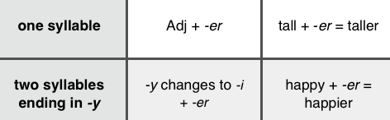

Rules

