Slide 1
Unit2: Countries, cultures and customs
Grade: 8th
Miss Pamela Knuckey

Slide 2
About Reading comprehension
Pay attention with the relevant information
Underline dates, names, places,etc
Pay attention with the questions after the text

Slide 3
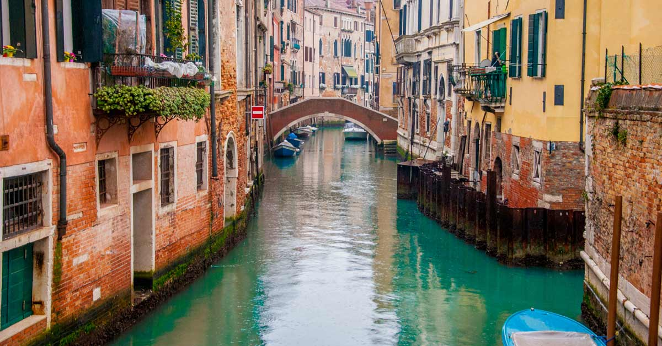
And remember
We are talking about countries and cultures
This class we are going to talk about Venice , a beautiful city located in Italy

