Slide 1
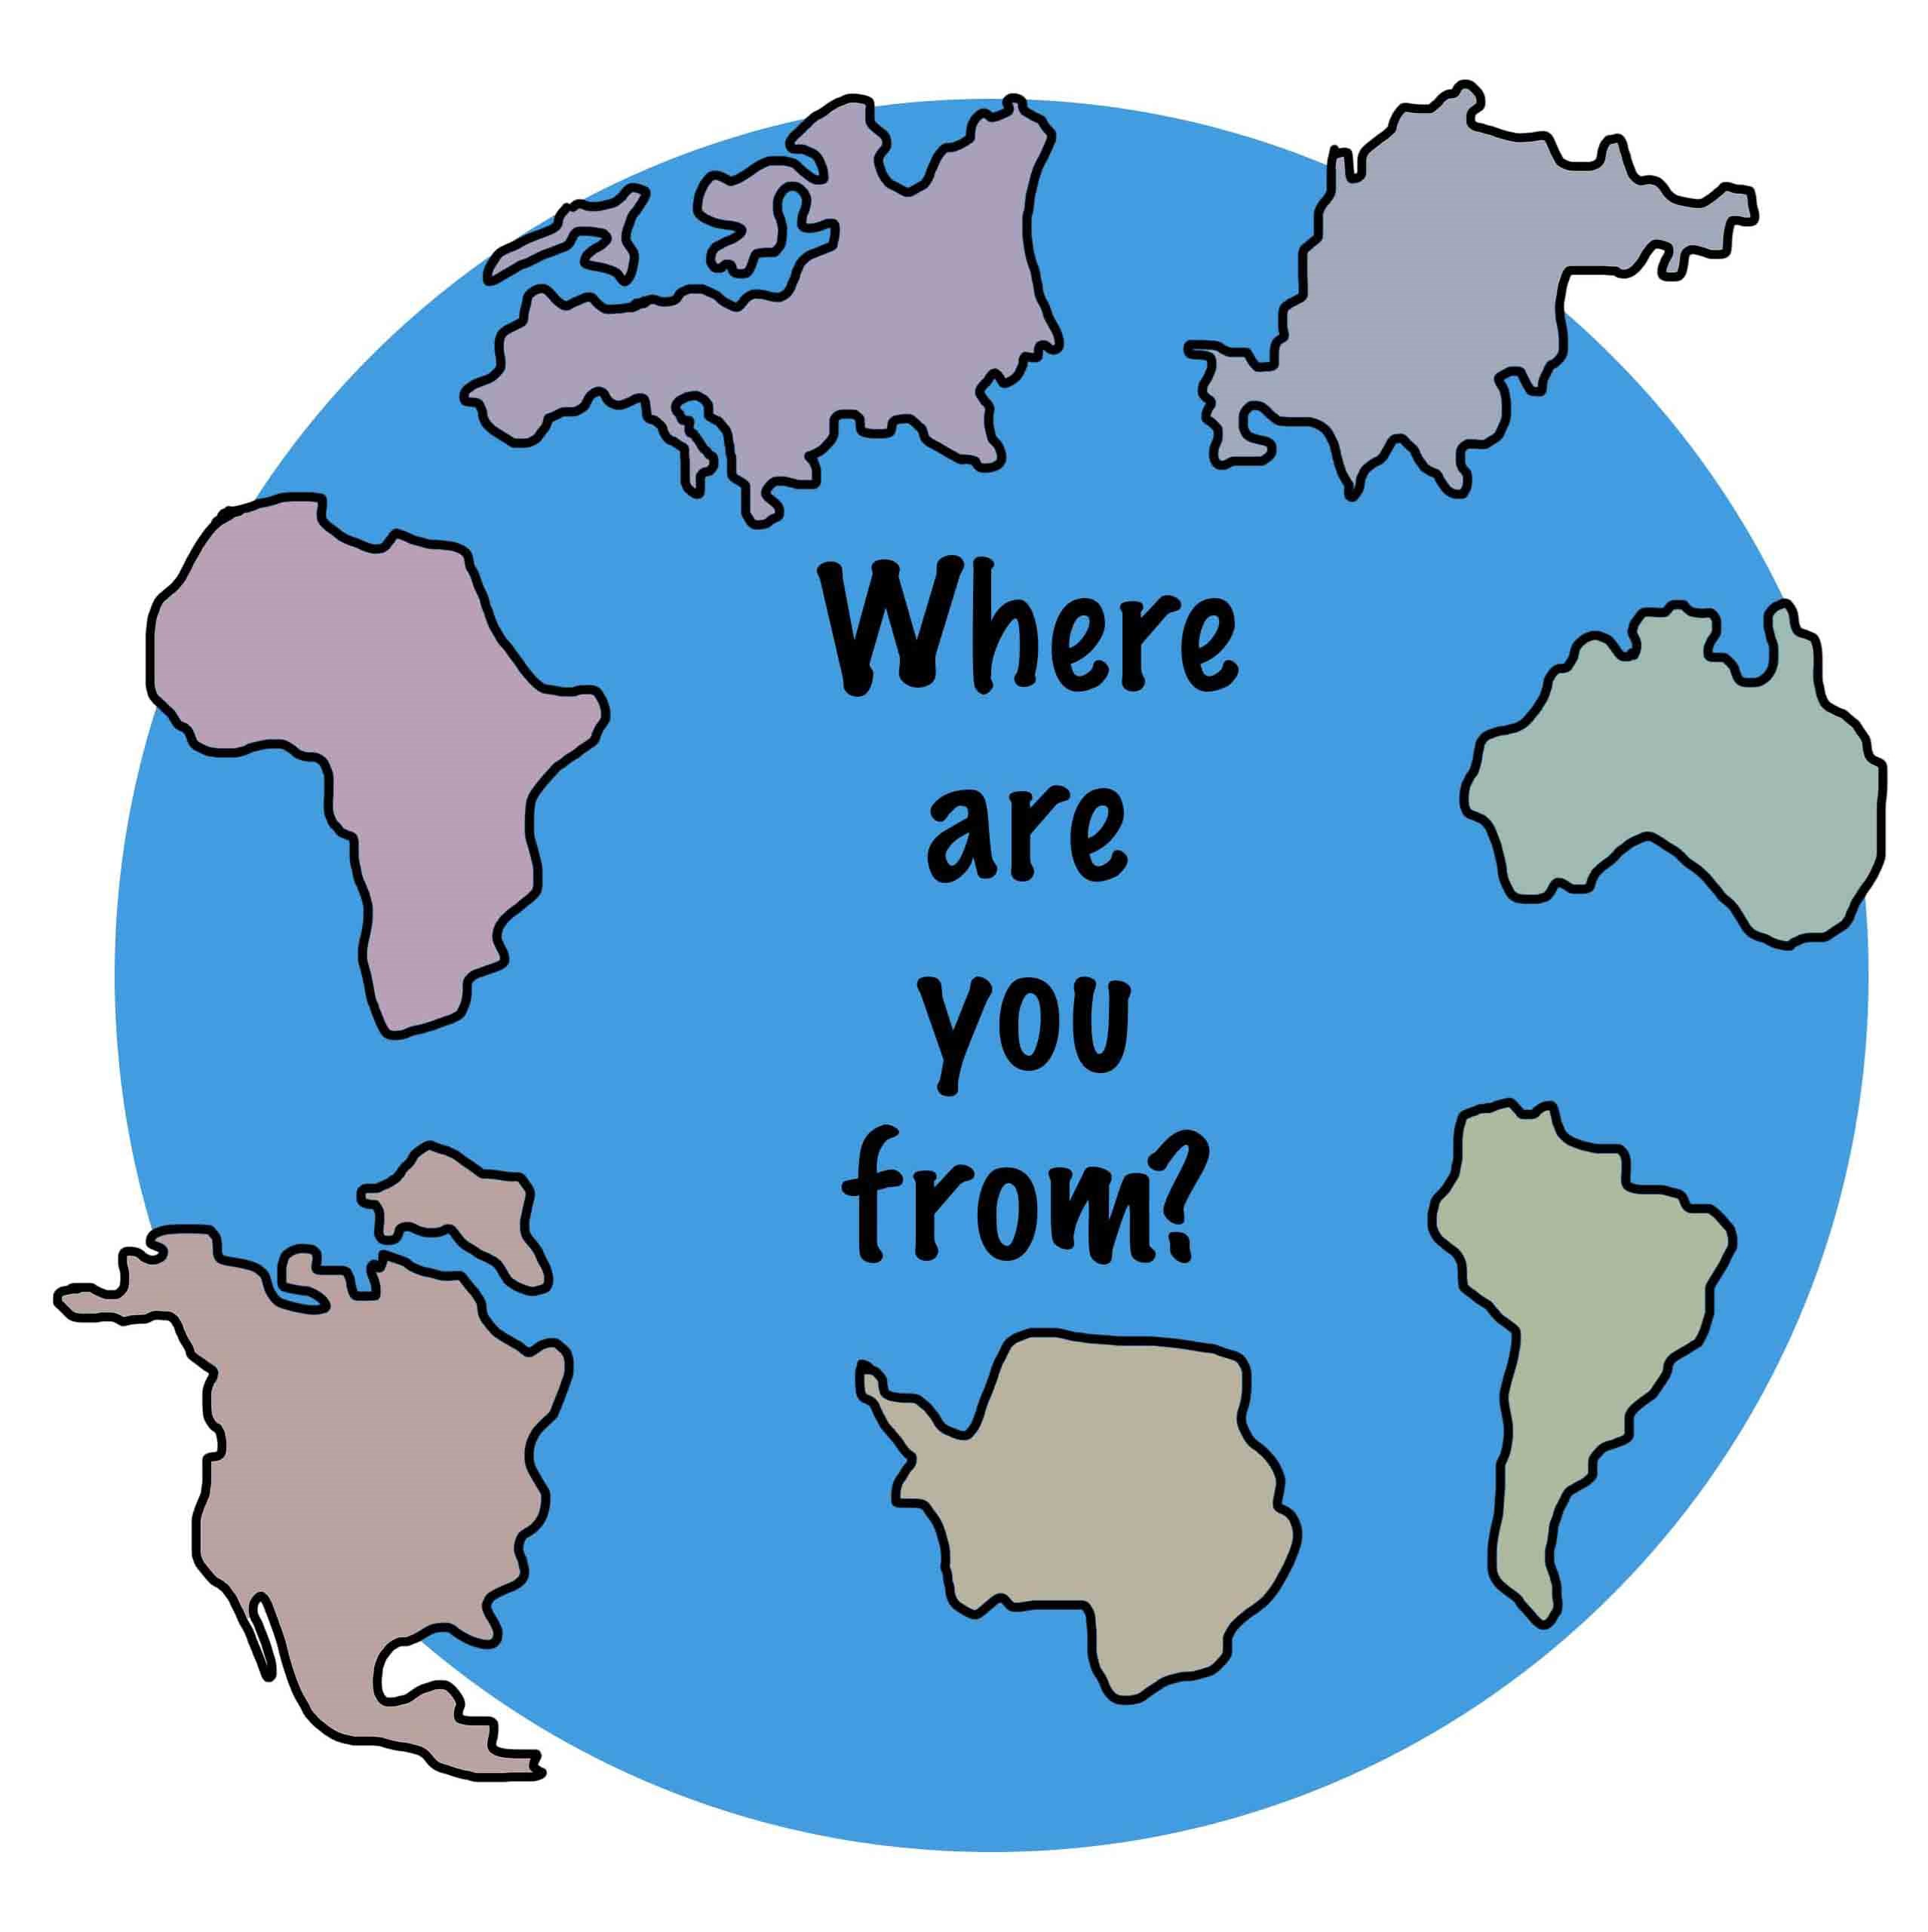
Unit2:Countries,cultures and customes
Grade: 8th
Miss Pamela Knuckey

Slide 2
About last class, What if we make a feedback?
Qué vimos la clase anterior?
Recuerdas alguna palabra del vocabulario visto en clases?
Para que usábamos el adjetivo calificativo ?
Podrías darme un ejemplo en inglés ?

Slide 3
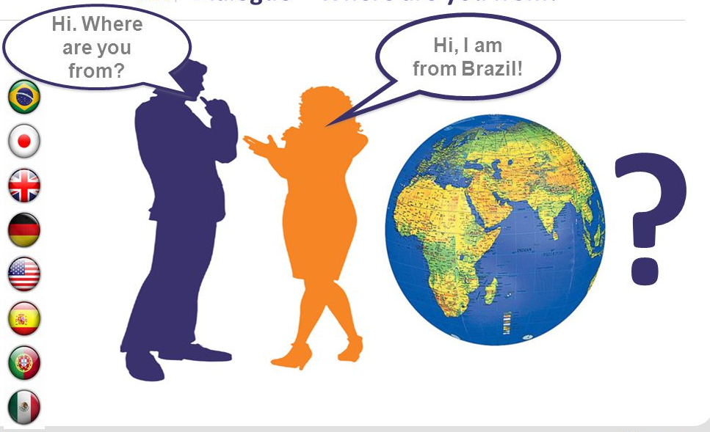
Today we’ll see : countries and demonyms
What is a denonym?
Qué es un gentilicio?

Slide 4
Gentilicios : demonyms
China
Demonym: chinese
United states
Demonym:American
Canada
Demonym: Canadian
Chile
Demonym : Chilean

Slide 5
Brazil Peru Japan Italy
Demonym:Brasilian Demonym: Peruvian Demonym:Japanese Demonym:Italian

Slide 6
France Germany Russia Argentina
Demonym: French Demonym: German Demonym: Russian Demonym: Argentinian

Slide 7
United kingdom Colombia Spain
Demonym: English Demonym: Colombian Demonym: Spanish

