Slide 1
Unit3: sport and free time activities
Grade: 7th
MISS PAMELA KNUCKEY

Slide 2
OBJECTIVE
Aplicar vocabulario relacionado a sport and free time activities

Slide 3
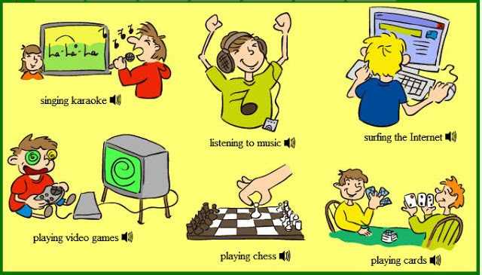
FREE TIME
WHAT DO YOU DO IN YOUR FREE TIME?

Slide 4
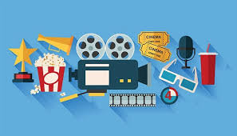
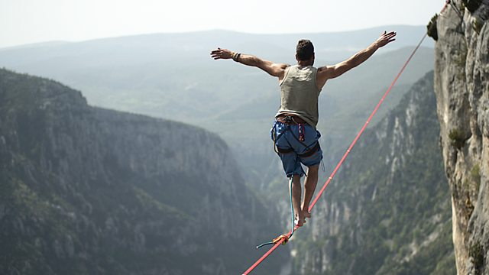
What do you prefer?
What kind of activities do you prefer?

Slide 5
