Slide 1
Unit3: sports and free time activities
Grade: 7 th Miss Pamela Knuckey

Slide 2
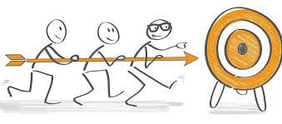
objective
Leer y comprender textos asociados a deportes.

Slide 3
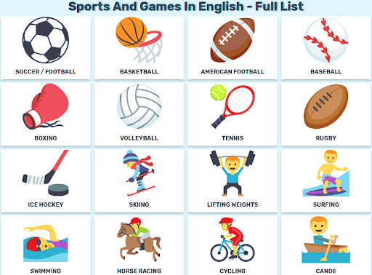
List of sports
Soccer: football
Handball: balón mano
Cycling: ciclismo
Boxing: boxeo
Swimming: natación
Gymnastics: gimnasia
Badminton
Golf: golf
Archery: tiro al arco

Slide 4
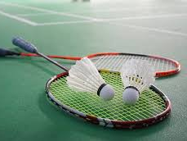
Traditional sports
Badminton

Slide 5
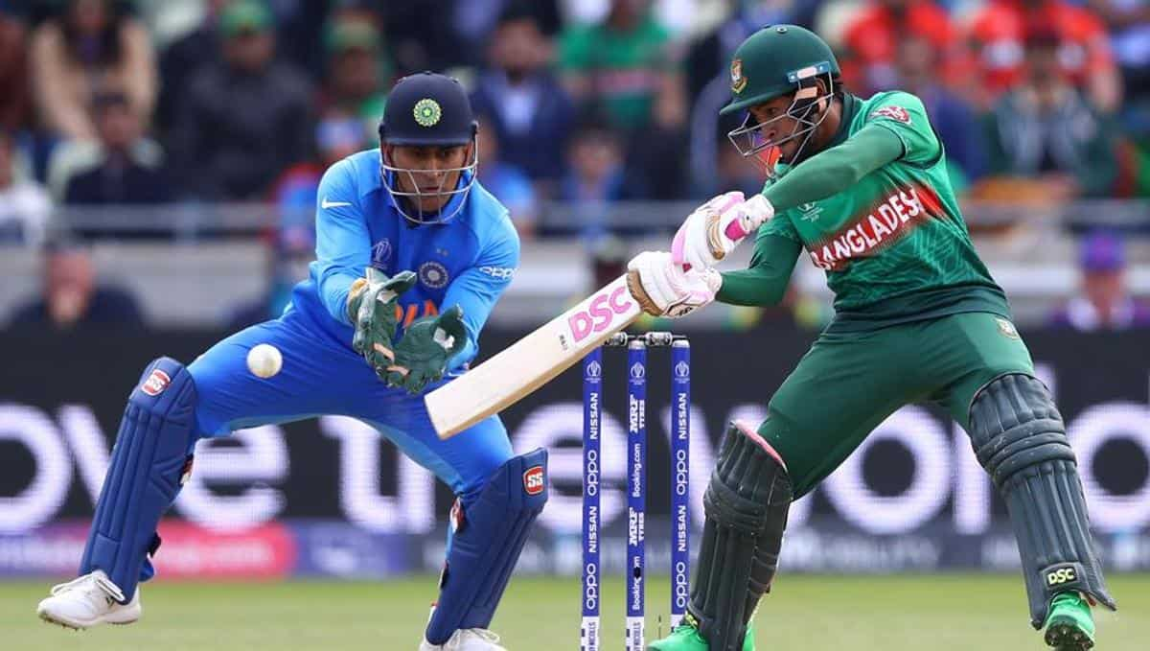
cricket

Slide 6
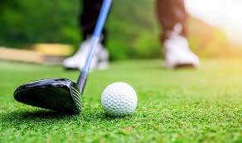
golf

