Slide 1
UNIT2: HEALTHY HABITS
Grade : 7th
Miss Pamela Knuckey

Slide 2
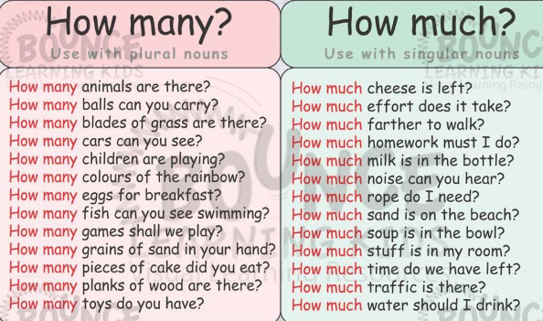
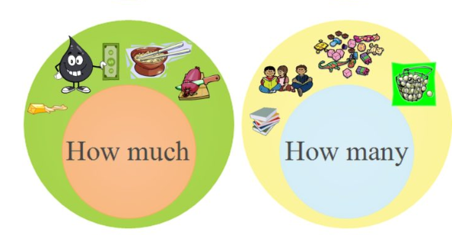
EXAMPLES

Slide 3
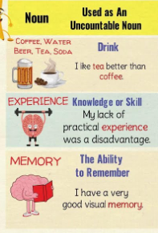
UNCOUNTABLE NOUNS
LIQUIDOS
SUSTACIAS
COSAS ABSTRACTAS
GRANOS, POLVOS
CLIMA

Slide 4
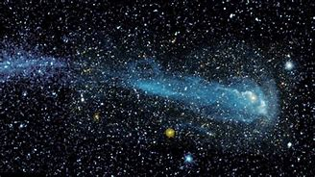
READ AND REPEAT
How many stars are there in the night sky? And how many animals know how to fly? How much ice cream do I eat in a week? And how many years does it take to learn Greek?
How much of the planet is covered in snow? And how many dinosaurs lived long ago? How much bright sunshine do plants need to grow? So many questions, so much I don’t know.

