Slide 1
Unit2: Healthy Habits
Grade: 7th
Miss Pamela Knuckey

Slide 2
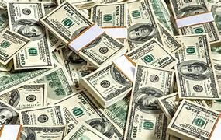
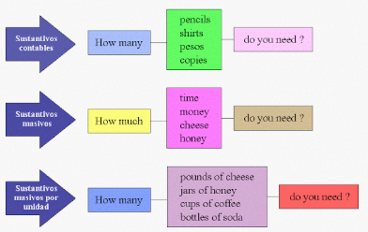
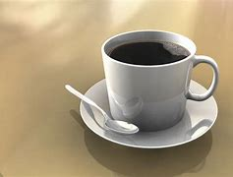
Today we’ll see about quantities

Slide 3
Recuerda que usamos:
Many: para las cosas contables
Much : para las cosas no contables

