Slide 1
Unit3:the natural world
Grade :6th miss pamela knuckey

Slide 2
Objective:
Leer y demostrar comprensión en textos asociados a celebraciones

Slide 3
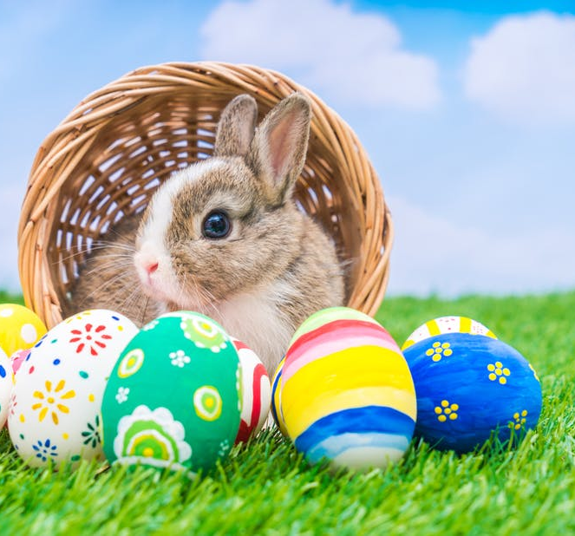
celebrations
EASTER
April

Slide 4
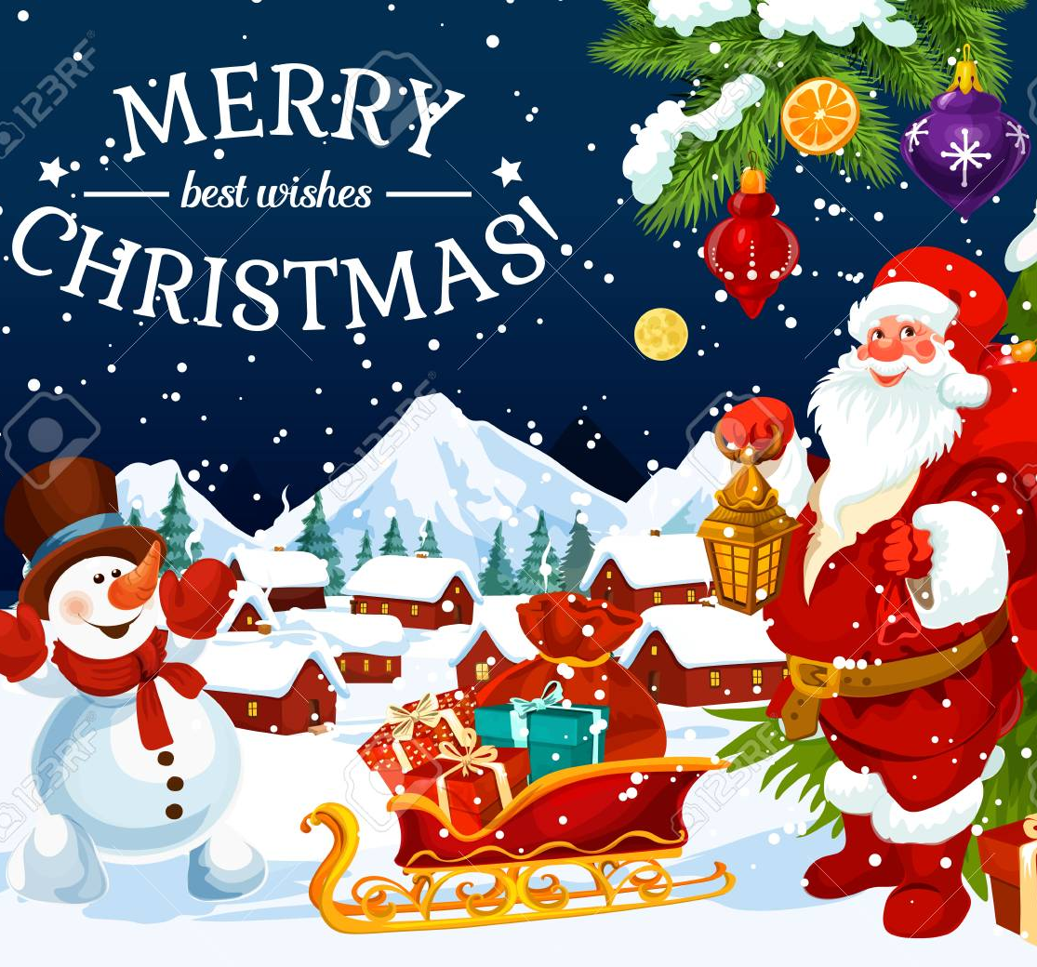
MERRY CHRISTMAS
December

Slide 5
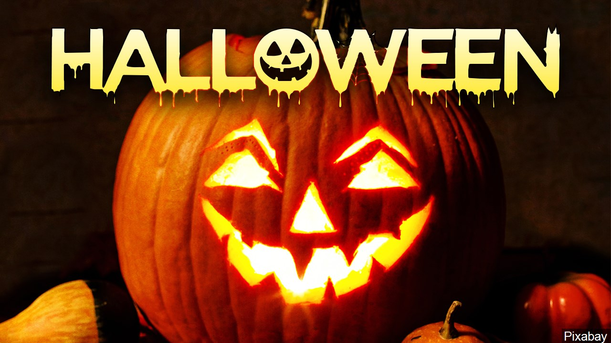
halloween
October

Slide 6
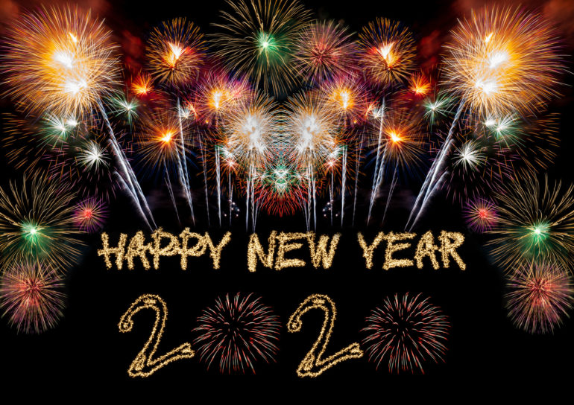
Happy new year
January

Slide 7
Valentine´s day
February

Slide 8
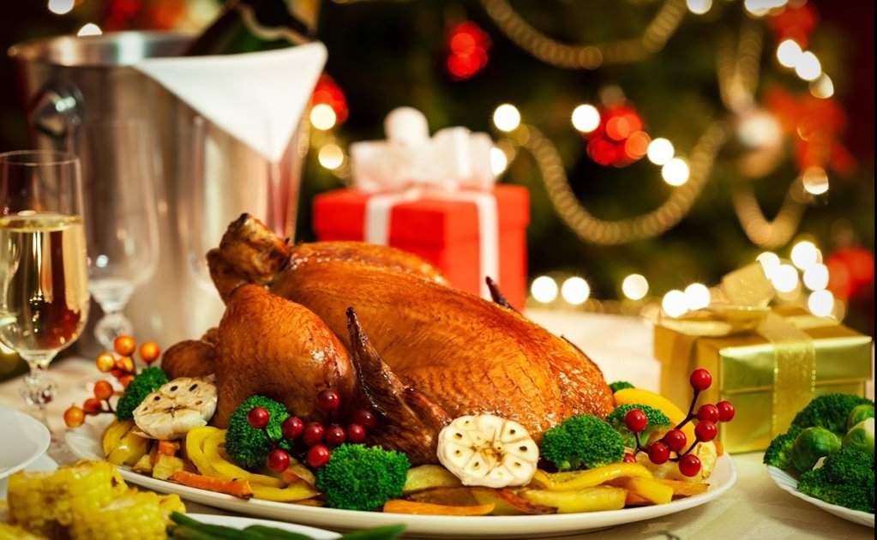
Thanksgiving day
November

