Slide 1
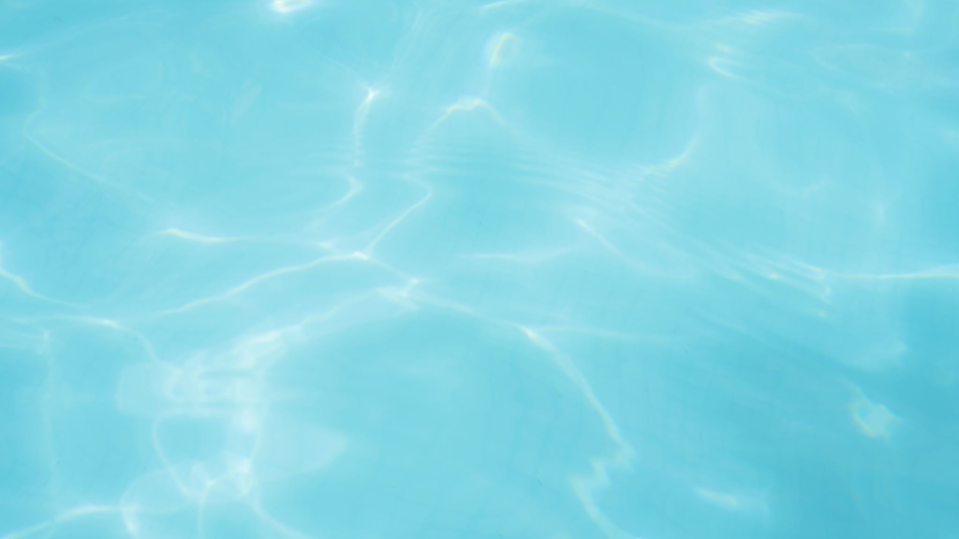
UNIT2: AROUND TOWN
GRADE: 6TH
MISS PAMELA KNUCKEY

Slide 2
ABOUT LAST CLASS
1- Do you remember what is a preposition of place?
2- could you name four preposition of place?
3- can you translate: el gato está debajo de la mesa?

Slide 3
OBJ:Reconocer las rutinas diarias en un texto. Today we are going to see daily routines

Slide 4
What is a daily routine? It´s something that you used to do everyday.
1- wake up : despertar
2- take a shower: ducharse
3- have breakfast: tomar desayuno
4- go to school: ir al colegio
5- have lunch : almorzar
5- do my homework: hacer mi tarea
6- have dinner: cenar
7- watch T.V: ver televisión
8- brush my teeth: lavarme los dientes
9- go to bed : ir a acostarse
10- play with Friends: jugar con amigos

Slide 5
Daily routines vocabulary
11- make my bed
12- walkinf the dog
13- do yoga
14- do exercises
15- read a book
16- cook something
17- play videogames
18- chat with my friends

