Slide 1
Unit2: Around Town
Grade: 6th
Miss Pamela Knuckey

Slide 2
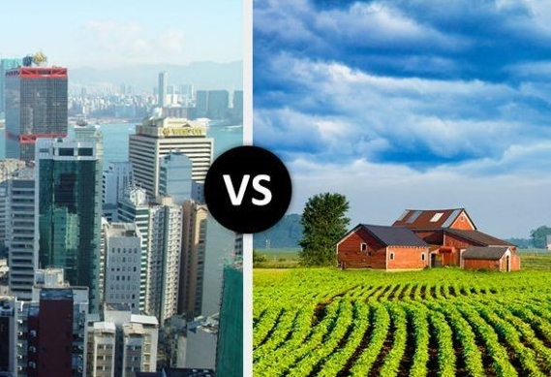
City or countryside?

Slide 3
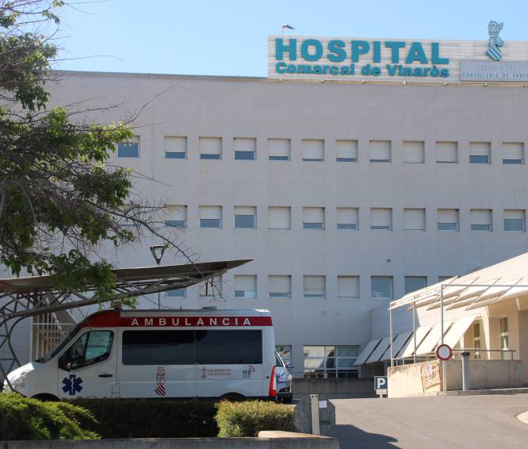
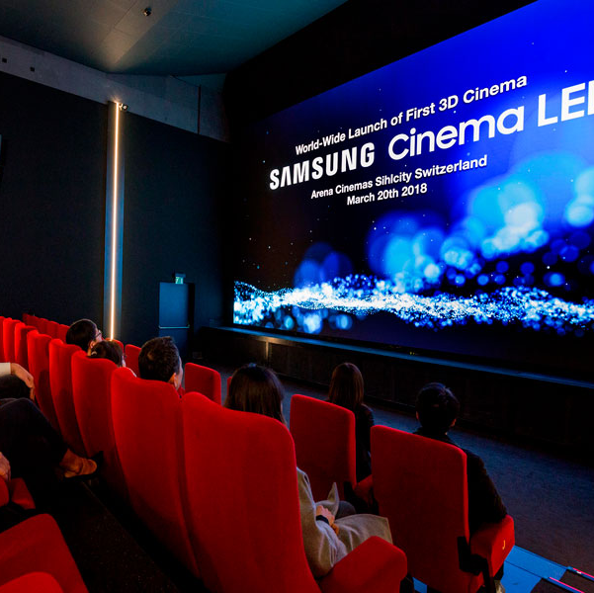
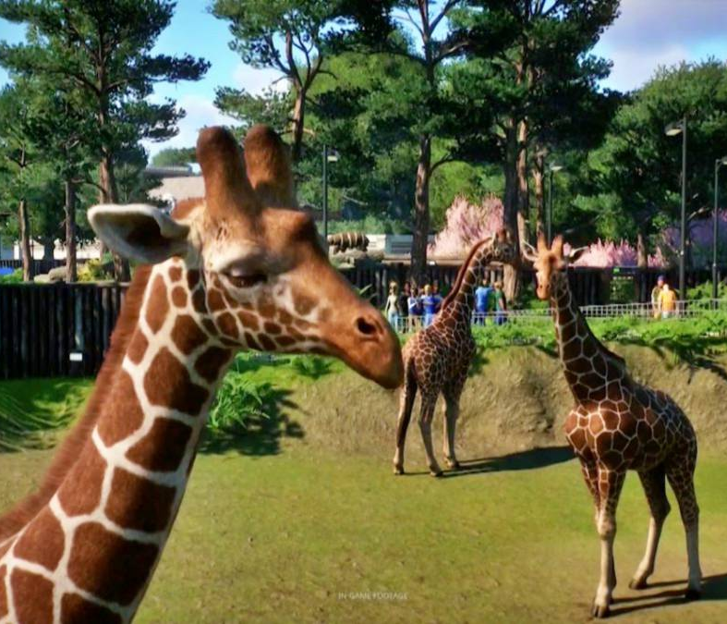
City places
Bank: banco
Cinemas: cine
Restaurants
Zoo: zoológico
Hospital

Slide 4
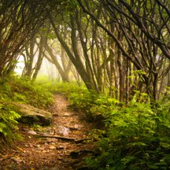
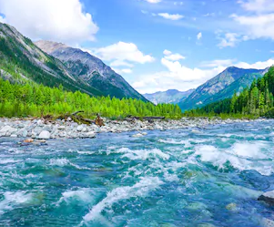
Countryside places:
Forest: bosque
Lakes: lagos
Sea: mar
Trees: arboles

