Slide 1
English class n°8
Miss Pamela Knuckey
Grade: 6 th

Slide 2
Today skill: writing

Slide 3
Temas vistos en la unidad 1
Food
Healthy &unhealthy
I like & I don´t like
Can& can’t
Personal pronouns
Possessive adjectives

Slide 4
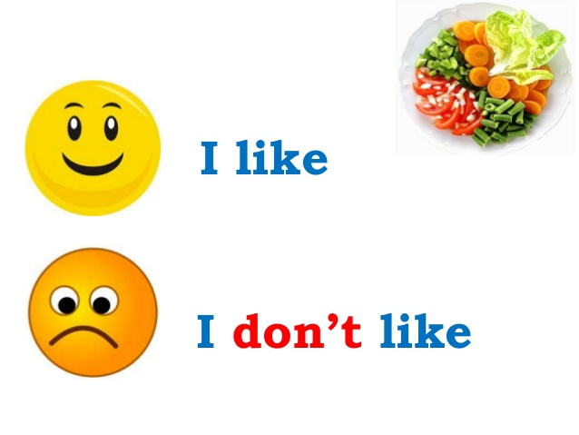
Goodbye unit 1

