Slide 1
I like ☺& I don´t like ☹
Grade: 6th
Unit 1: Food and health
I like &I don´t like

Slide 2
Do you remember the last class?
De qué hablamos la clase anterior?
Podrías nombrarme tres palabras vistas en la clase anterior?
Podrías darme un ejemplo del concepto “healthy food”?
Cuales eran las tres comida del día en inglés?

Slide 3
I like this! ☺ & I don’t like this! ☹
There are many food that you like it and you don’t. Today we are going to express what kind of food I like and what kind of food I don’t like .

Slide 4
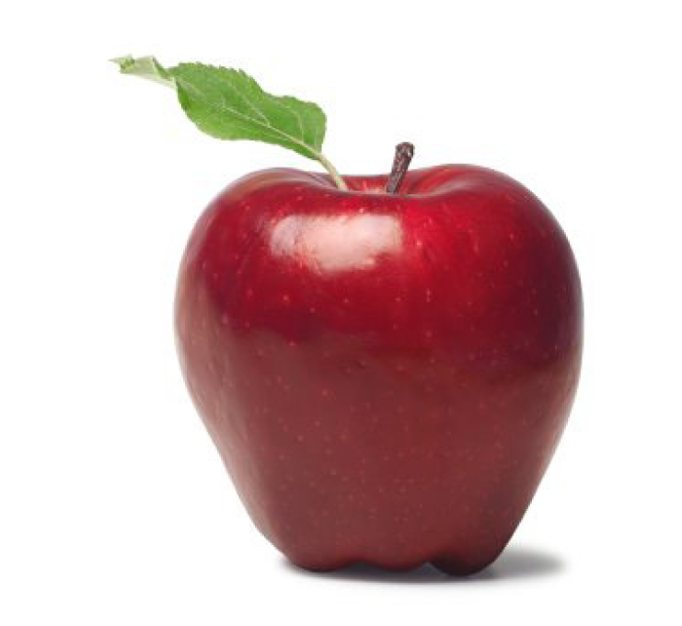
I like apples ☺ because they are healthy…..

Slide 5
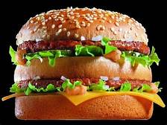
I don’t like Burger ☹ because it is unhealthy

Slide 6
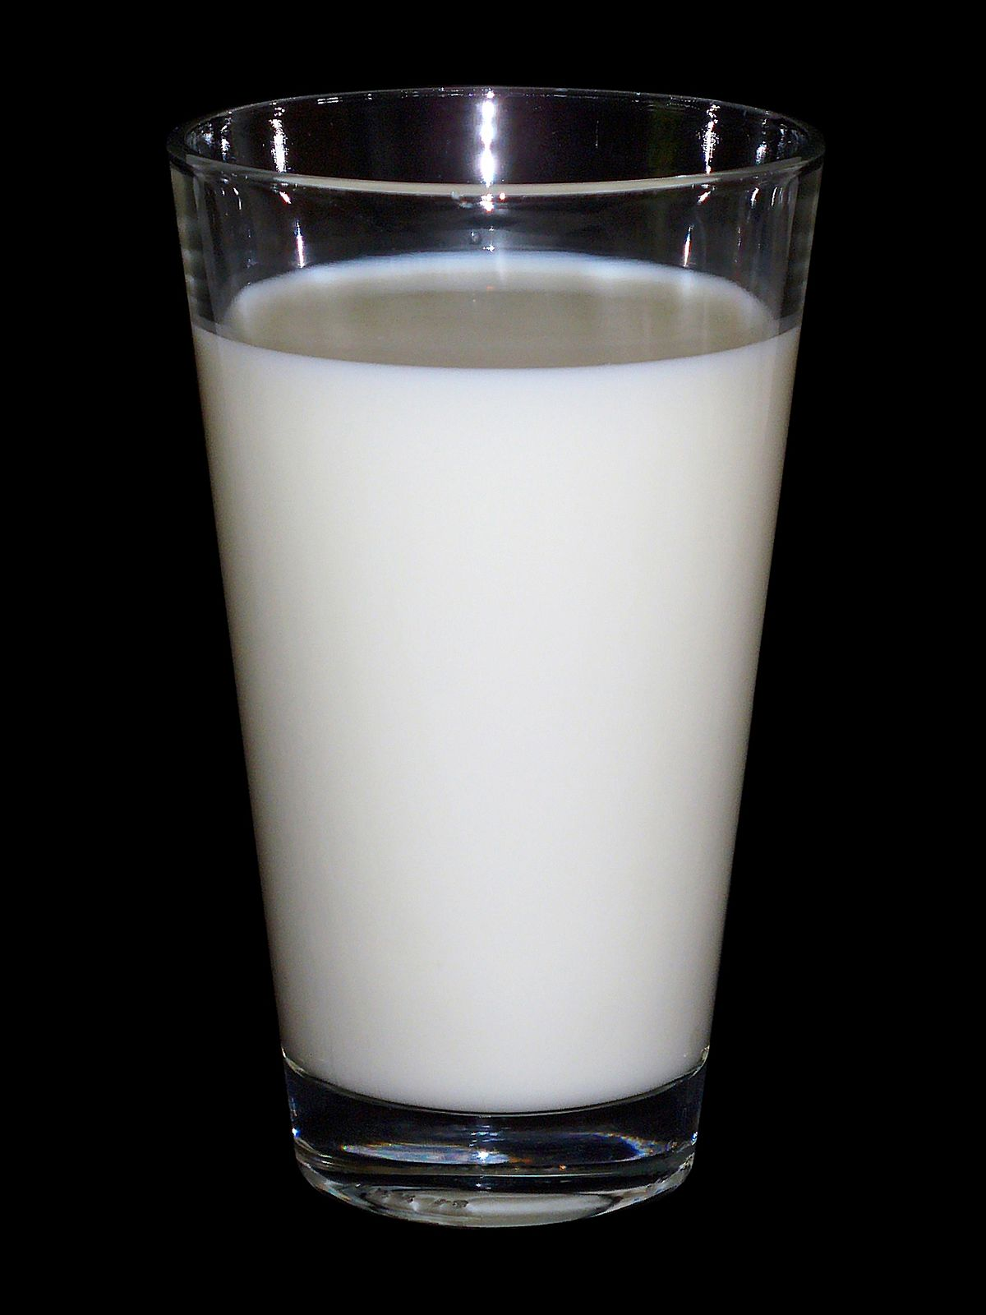
I like milk ☺

Slide 7
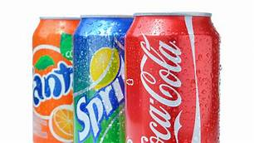
I don’t like soda ☹

Slide 8
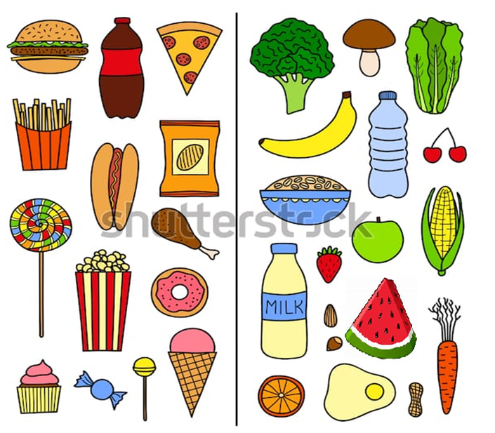

Now it’s your turn! Look at the picture and tell me what food you like or you don’t like.

Slide 9
Remember! : use the structure to express your ideas .
I like fruits I don’t like vegetables

