Slide 1
UNIT3:what we eat
Grade:5th Miss Pamela Knuckey

Slide 2
OBJ ☺
LEER Y COMPRENDER TEXTOS ASOCIADOS A LA COMIDA

Slide 3
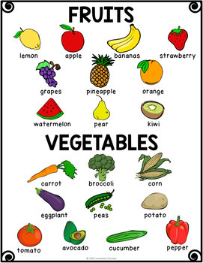
Food vocabulary
FRUITS & VEGETABLES

Slide 4

Three meals
Breakfast –DESAYUNO
EGGS
FRUITS
WATER
COFFEE
MILK
JUICE

Slide 5

lunch
ALMUERZO
MEAT
VEGETABLES
RICE
FRUITS
WATER
JUICE

Slide 6
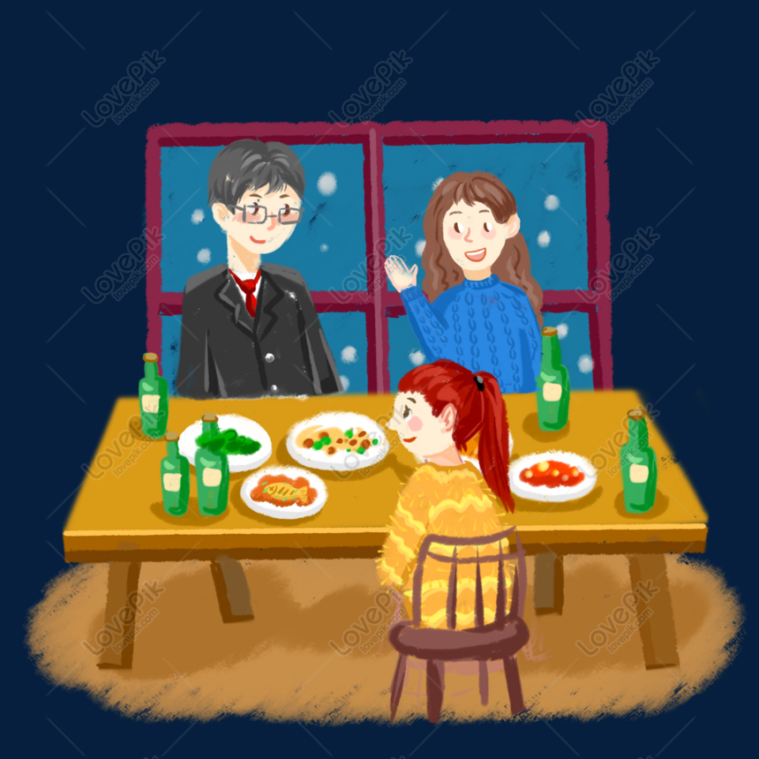
Dinner
CENA (ONCE)
PIZZA
BRAD
EGGS
MILK
WATER
JUICE
FRUITS
VEGETABLES

