Slide 1
Unit2: the place where i live
Grade : 5th
Miss Pamela Knuckey

Slide 2
ABOUT LAST CLASS…
What is a preposition of place?
Can you name at least 5?

Slide 3
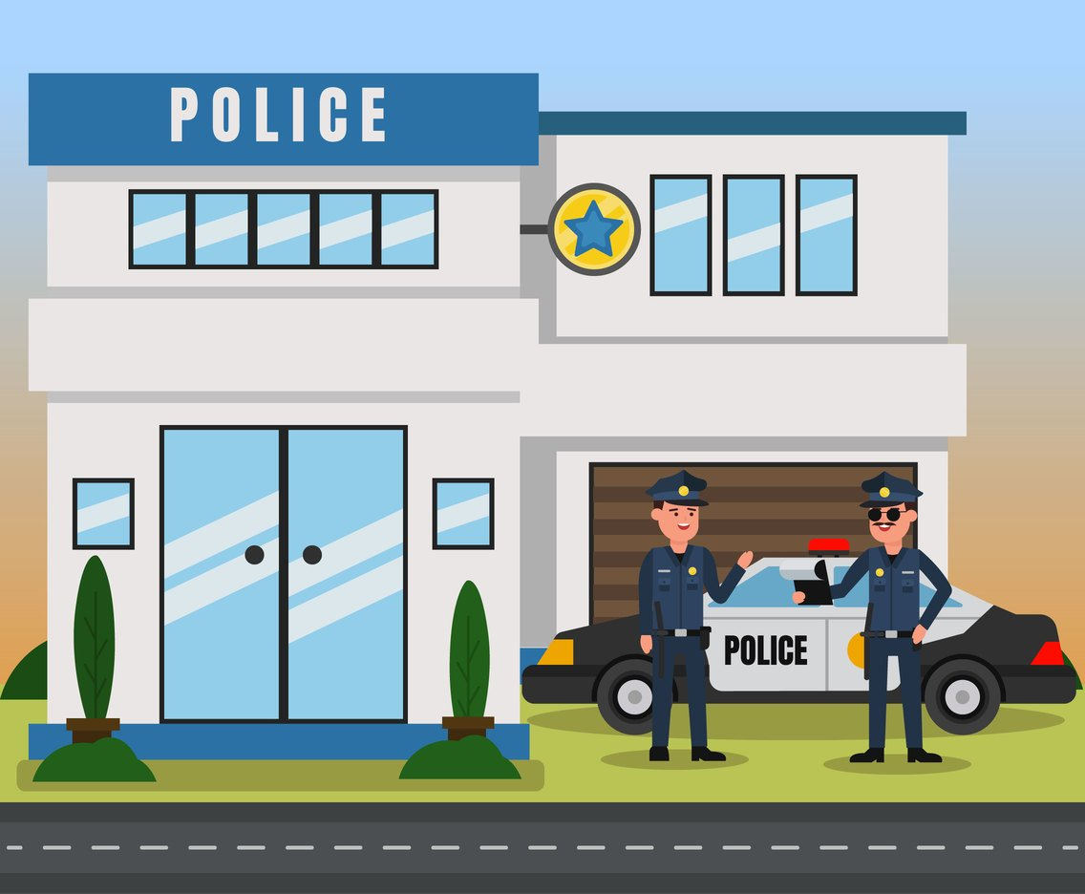
LET´S INTRODUCE PLACES IN TOWN-obj:Reconocer e identificar lugares de una ciudad
Church police station bank

Slide 4
Places in town
School library cinema

Slide 5
Places in town
Hospital drugstore zoo

