Slide 1
UNIT2: The place where i live
Grade: 5th
Miss Pamela Knuckey

Slide 2
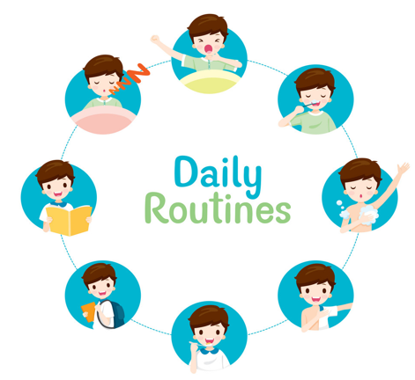
Last class….
Name five daily routines ….
1- ________________
2- ________________
3- ________________
4- ________________
5- ________________

Slide 3
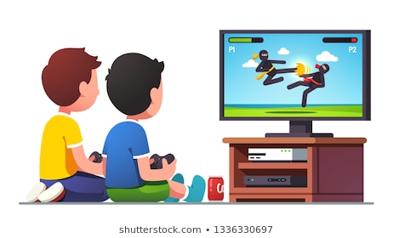
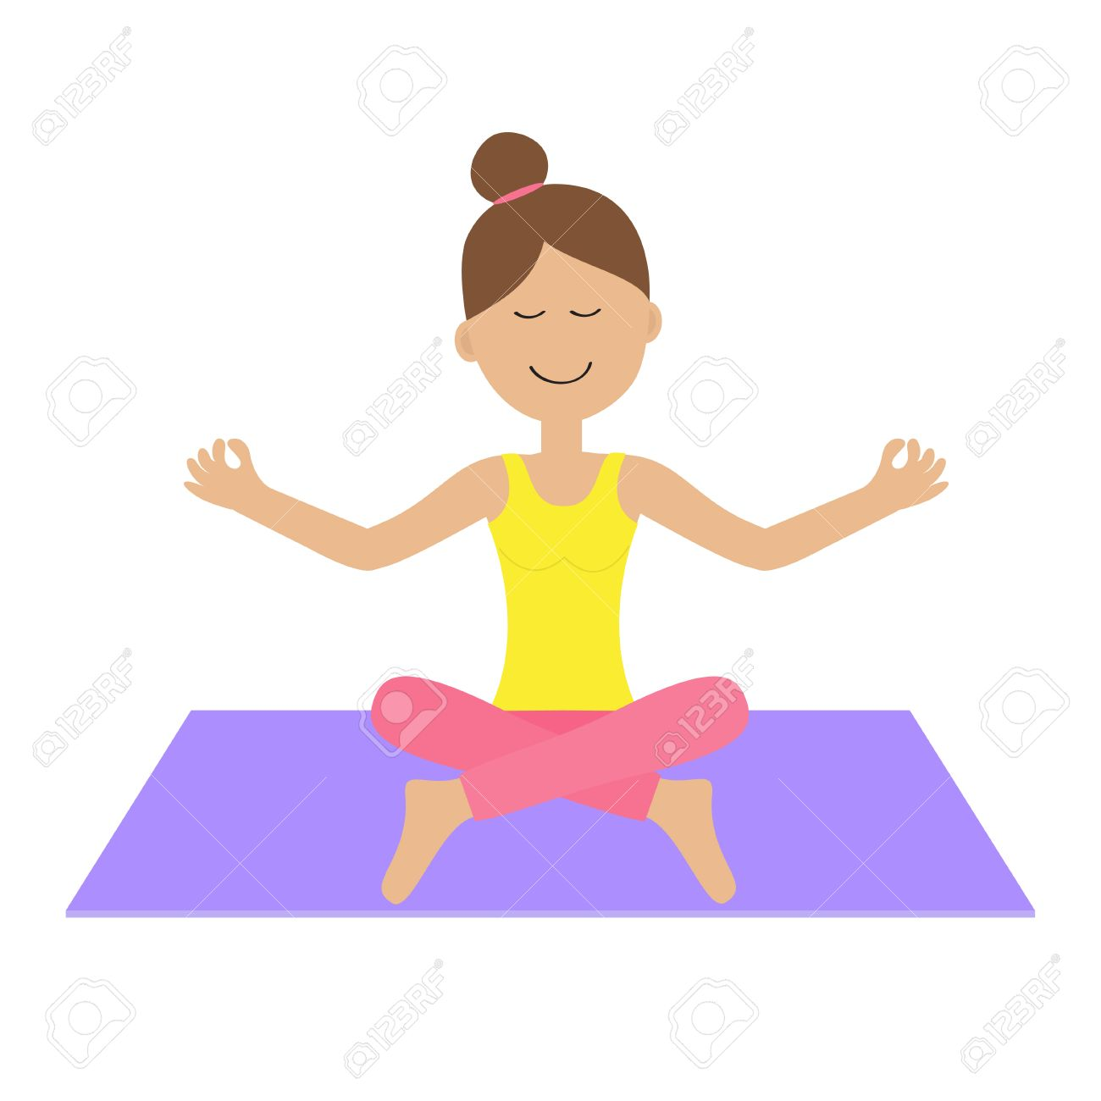
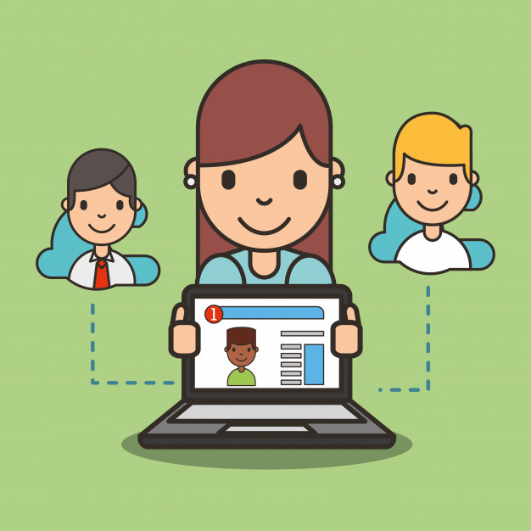
Remember ☺
Si tu quieres puedes agregar más vocabulario a tu rutina diaria como :
Do exercices
Read a book
Do yoga
Chat with Friends
Cook something ( cake, bread, desserts )
Play videogames

