Slide 1

Unit2: The place where I live
Grade: 5th
Miss Pamela Knuckey

Slide 2
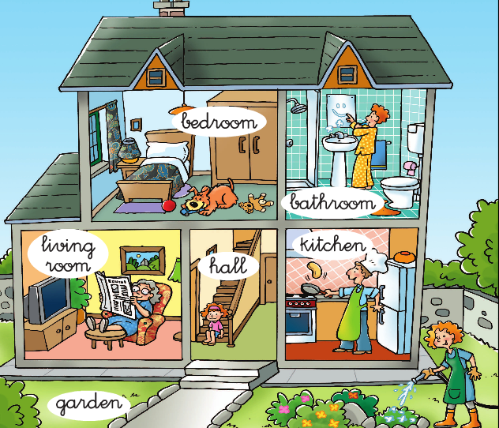
Welcome to the unit 2 ☺
Today we´ll see….. My house
Rooms of my house like; bedroom, bathroom, kitchen
Objects of my house like; lamp,bed,chair

Slide 3
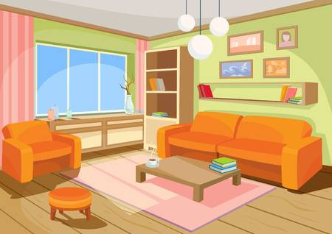
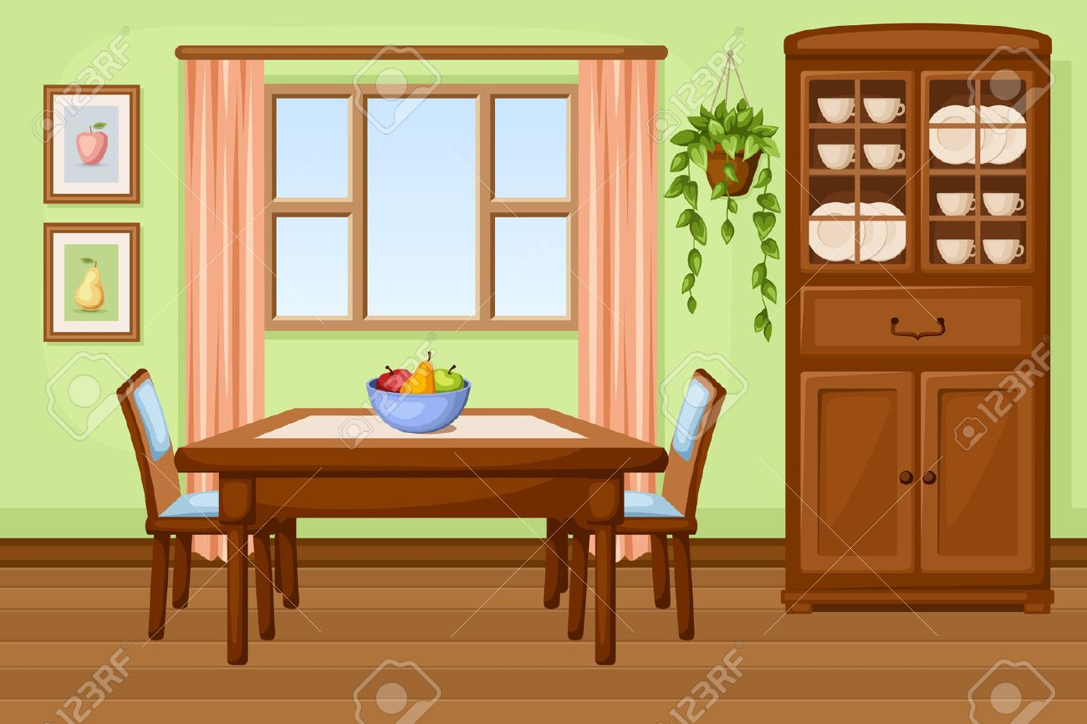
Living room
Dining room

Slide 4
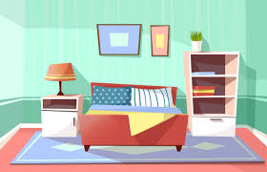
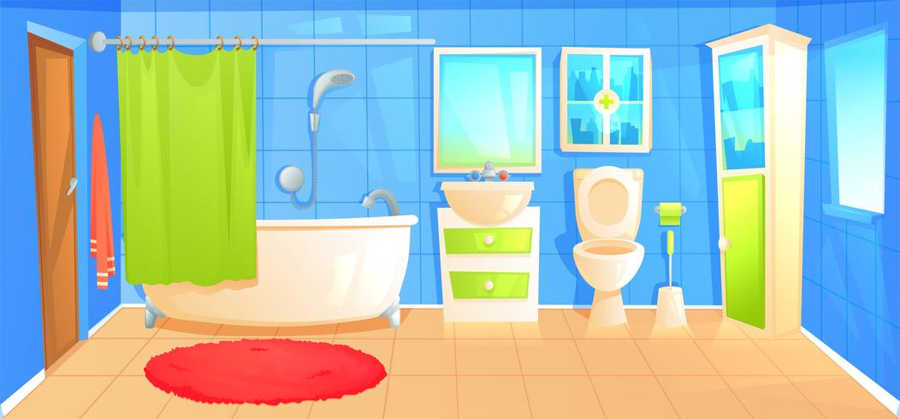
bedroom
bathroom

Slide 5
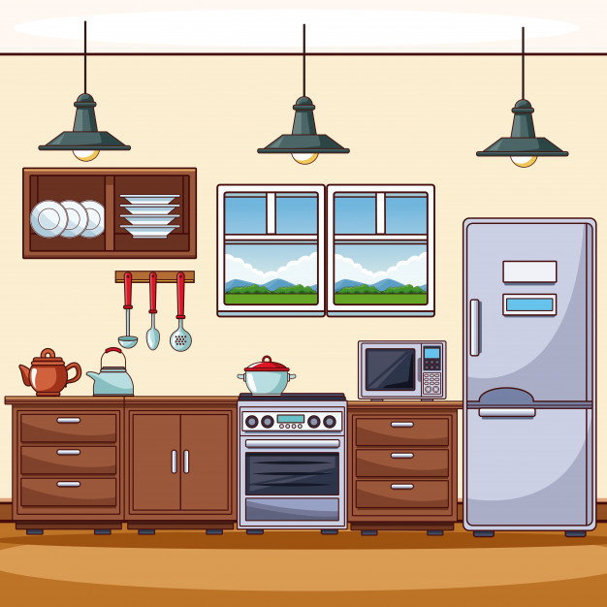
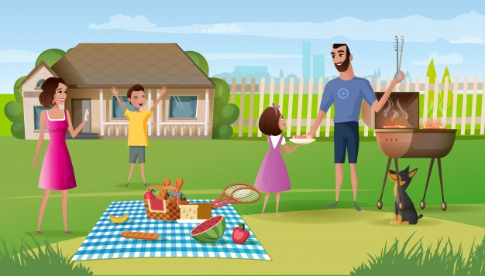

kitchen
backyard
garden

Slide 6
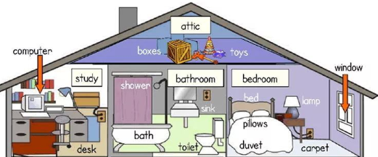
Vocabulary:
1- attic: ático
2-boxes: cajas
3- toys: juguetes
4- computer: computador
5-desk: escritorio
_________________
6-shower: ducha
7-bath: bañera
8-toilet:baño
Toothbrush: cepillo de dientes
_________________
9-bed:cama
10-pillows: almohada
11-carpet:alfombra
12-duvet: funda
13-lamp: lampara
14: window: ventana

Slide 7
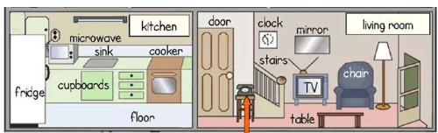
Vocabulary:
1- fridge: refrigerador
2-microwave: microondas
3- floor: piso
4-cupboards: lugar para guardar las tazas ,platos.
5-cooker: cocina
6-sink:lavabo
________________
7-door: puerta
8-clock: reloj muralla
9-stairs: escaleras
10-table:mesa
11-chair: silla
12-TV:televisor
13-mirror: espejo
_________________

