Slide 1
English class n° 8
Miss Pamela Knuckey
Grade: 5th

Slide 2
Today skill: writing

Slide 3
Temas vistos en la unidad 1
Members of my family
Feelings
My classroom
There is & there are- numbers 1-20
Personal pronouns

Slide 4
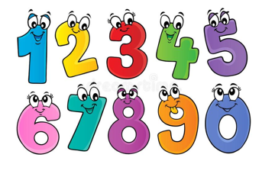
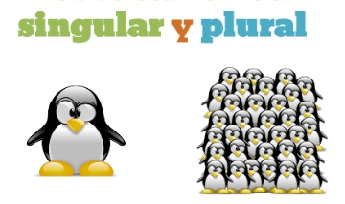
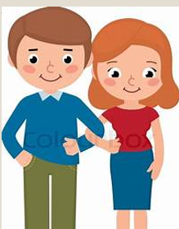
Goodbye unit 1 ☺

