Slide 1
MY CITY

Slide 4
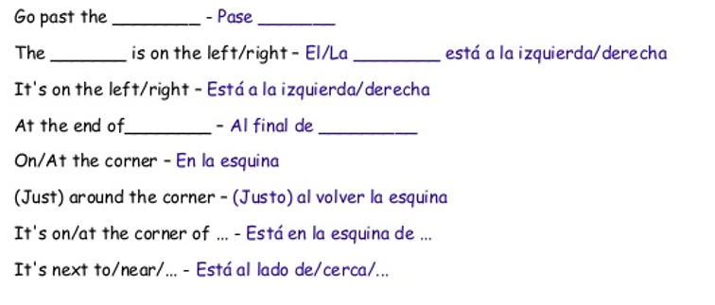

Slide 5
https://www.youtube.com/watch?v=AgTkKGM0TWE
https://www.youtube.com/watch?v=IDEuyJwOiyA

