Slide 1
THE NATURAL WORLD
https://www.youtube.com/watch?v=8gp42yzkEtg&t=31s

Slide 2
SAVANNAh

Slide 3
OCEAN

Slide 4
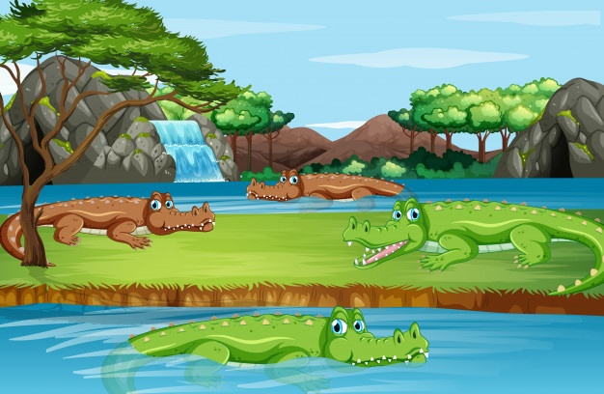
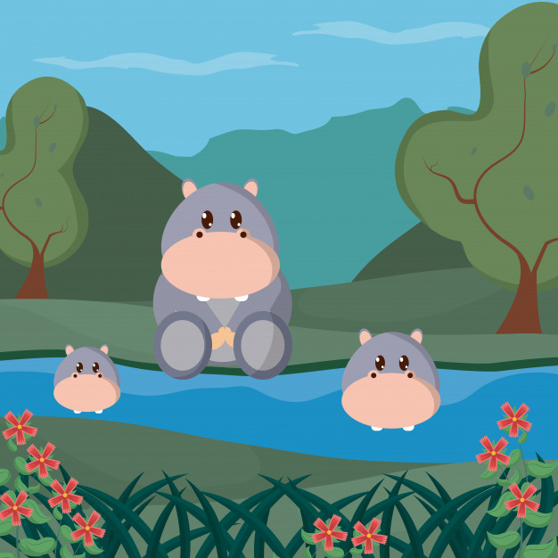
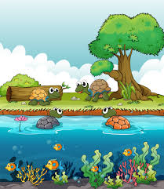
RIVER

Slide 5
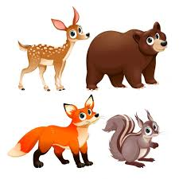
FARM FOREST

Slide 6
DOMESTICS POLAR

Slide 7
FOREST

