Slide 1
THE CLOTHES LA ROPA

Slide 2
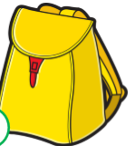

Slide 3
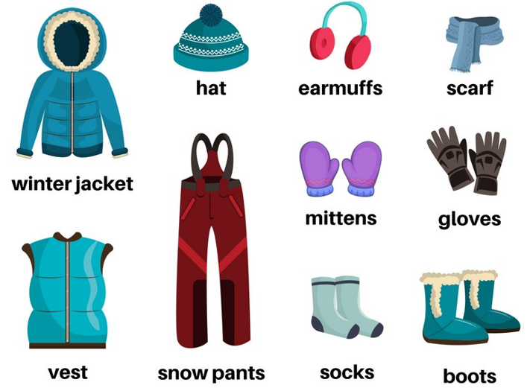
WINTER CLOTHES

Slide 4
SUMMER CLOTHES

Slide 5
VOCABULARY
Hat --- sombrero Cap --- gorro Shirt --- camisa
Sweater -- chaleco Jacket --- chaqueta
Skirt --- falda Tracksuit -- buzo Shoes – zapatos
Socks ---calcetines Trousers – pantalones Dress – vestido
Coat –abrigo Gloves – guantes Scarf – bufanda
T-shirt –polera Sandals – Sandalias Shoes –zapatos
https://www.youtube.com/watch?v=k2iXBhzTgRU

Slide 6
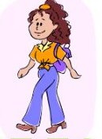
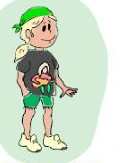
Uso del verbo vestir en inglés. Wearing
She is wearing jeans, a t-shirt, boots and a bag. (Ella viste jeans, una polera, botas y una cartera.)
He is wearing shorts, a t-shirt and trainers.

