Slide 1

Reading COMPREHENSION

Slide 2


Slide 3
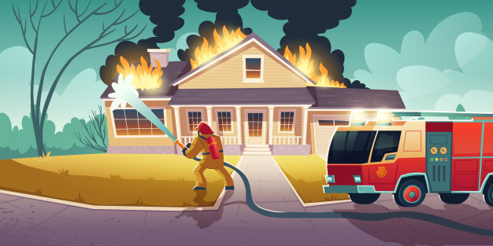
PUTS ON FIRE

Slide 4




Slide 5



Slide 6
