Slide 1


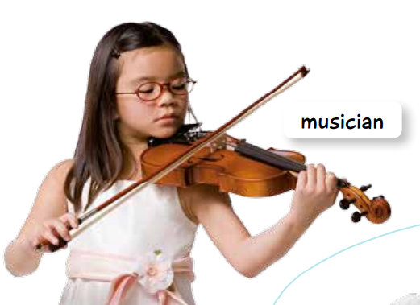


Slide 2




Slide 3


https://www.youtube.com/watch?v=3jtfUyAcFBU

Slide 4

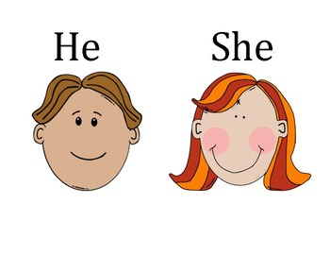

Slide 5
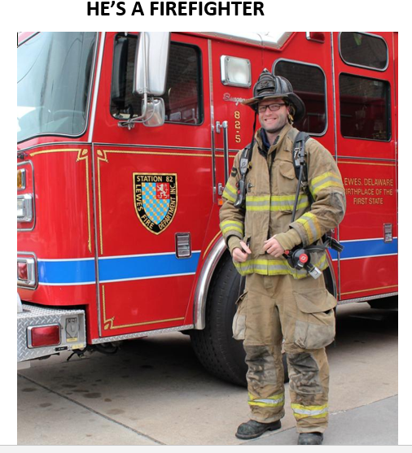


Slide 6



