Slide 1

https://www.youtube.com/watch?v=jBfb33_KHU&ab_channel=SuperSimpleSongs-KidsSongs

Slide 2
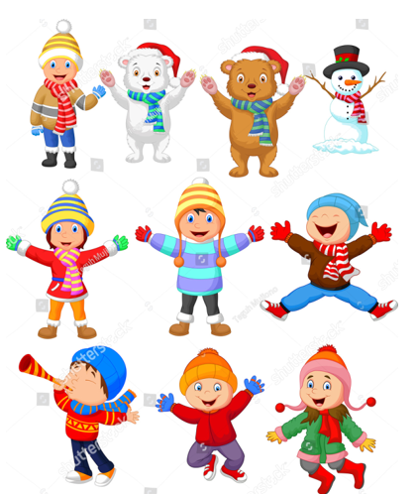
WINTER CLOTHES

Slide 3


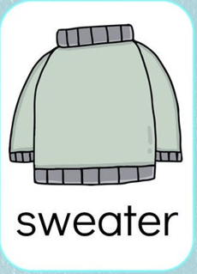
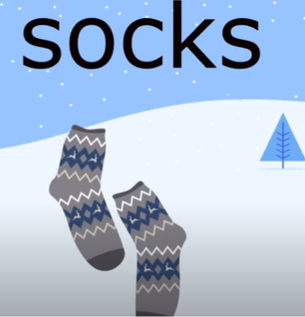

Slide 4

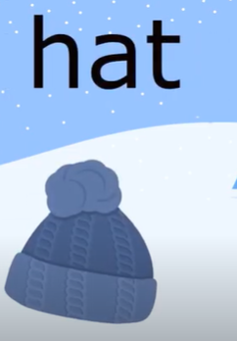

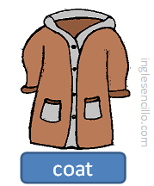
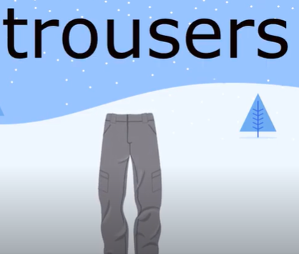

Slide 5
