Slide 1


Slide 2
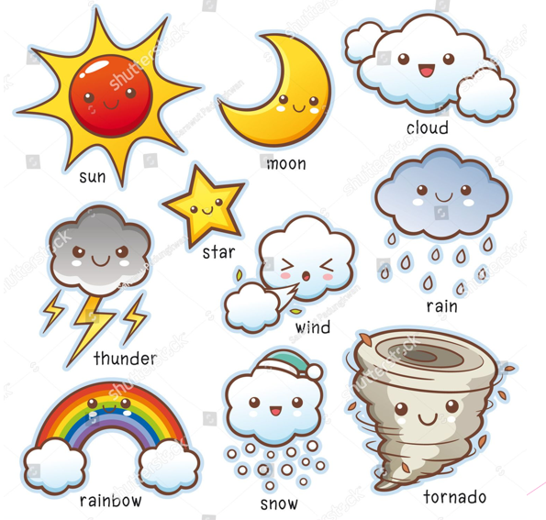

Slide 3
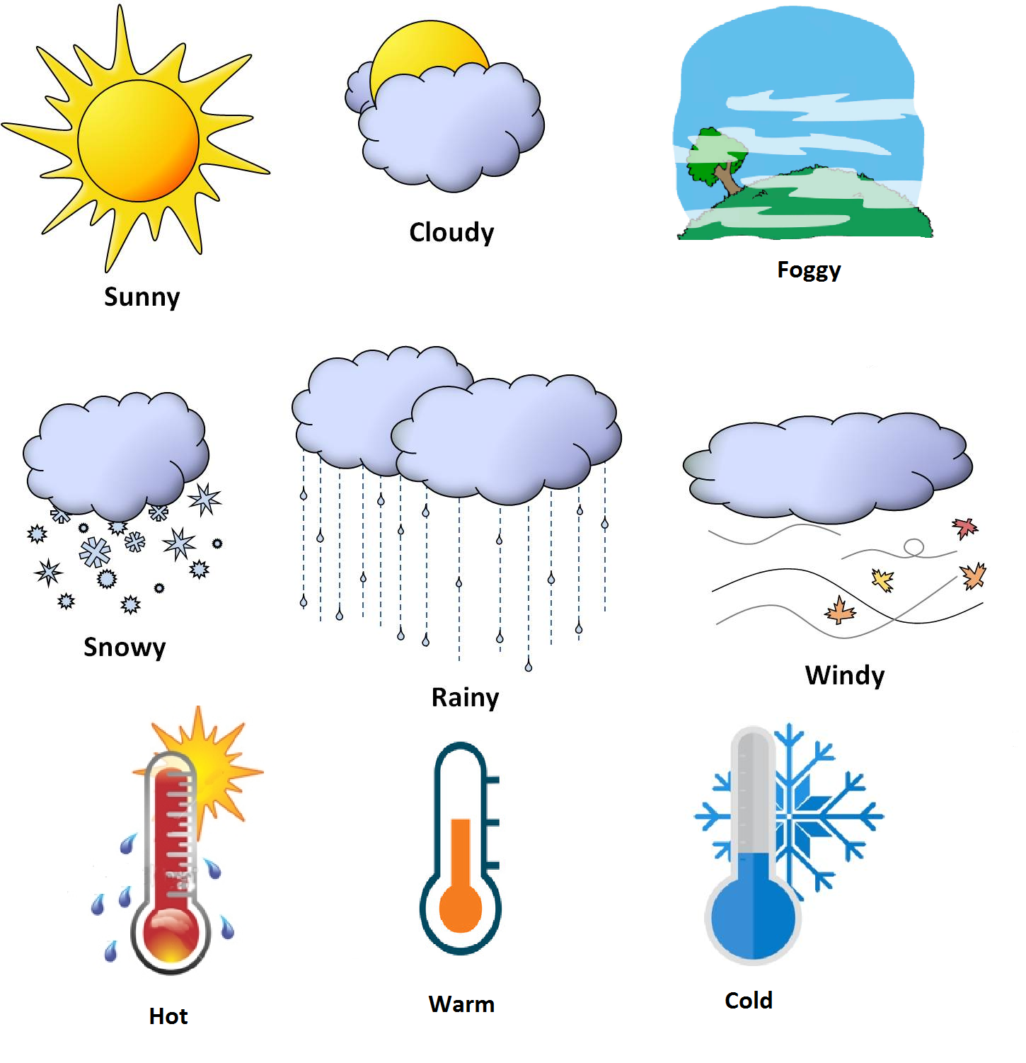

Slide 4
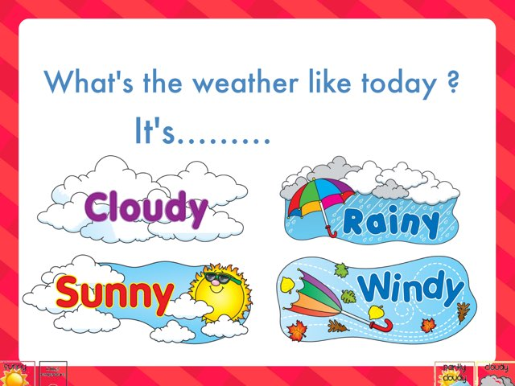
https://www.youtube.com/watch?v=XcW9Ct000yY&ab_channel=DreamEnglishKids

