Slide 1
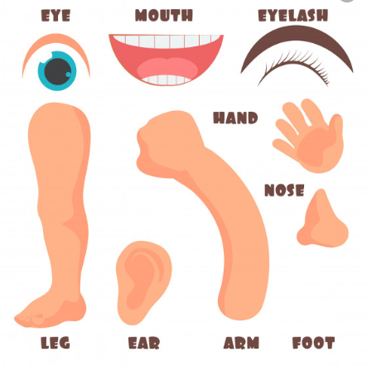

MY BODY

Slide 2
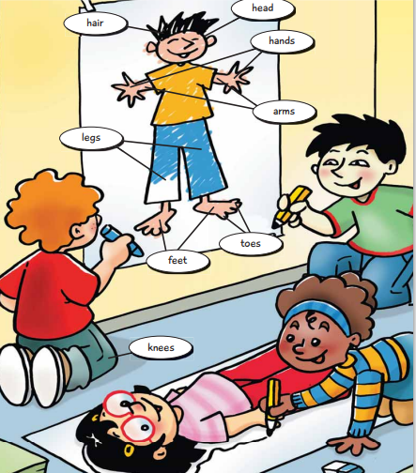

Slide 3
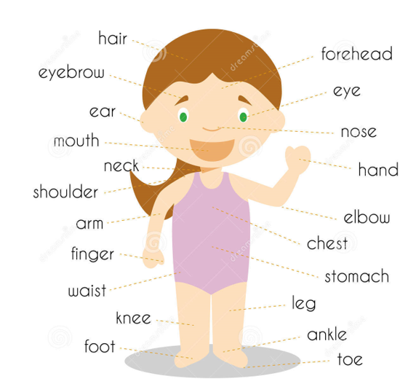
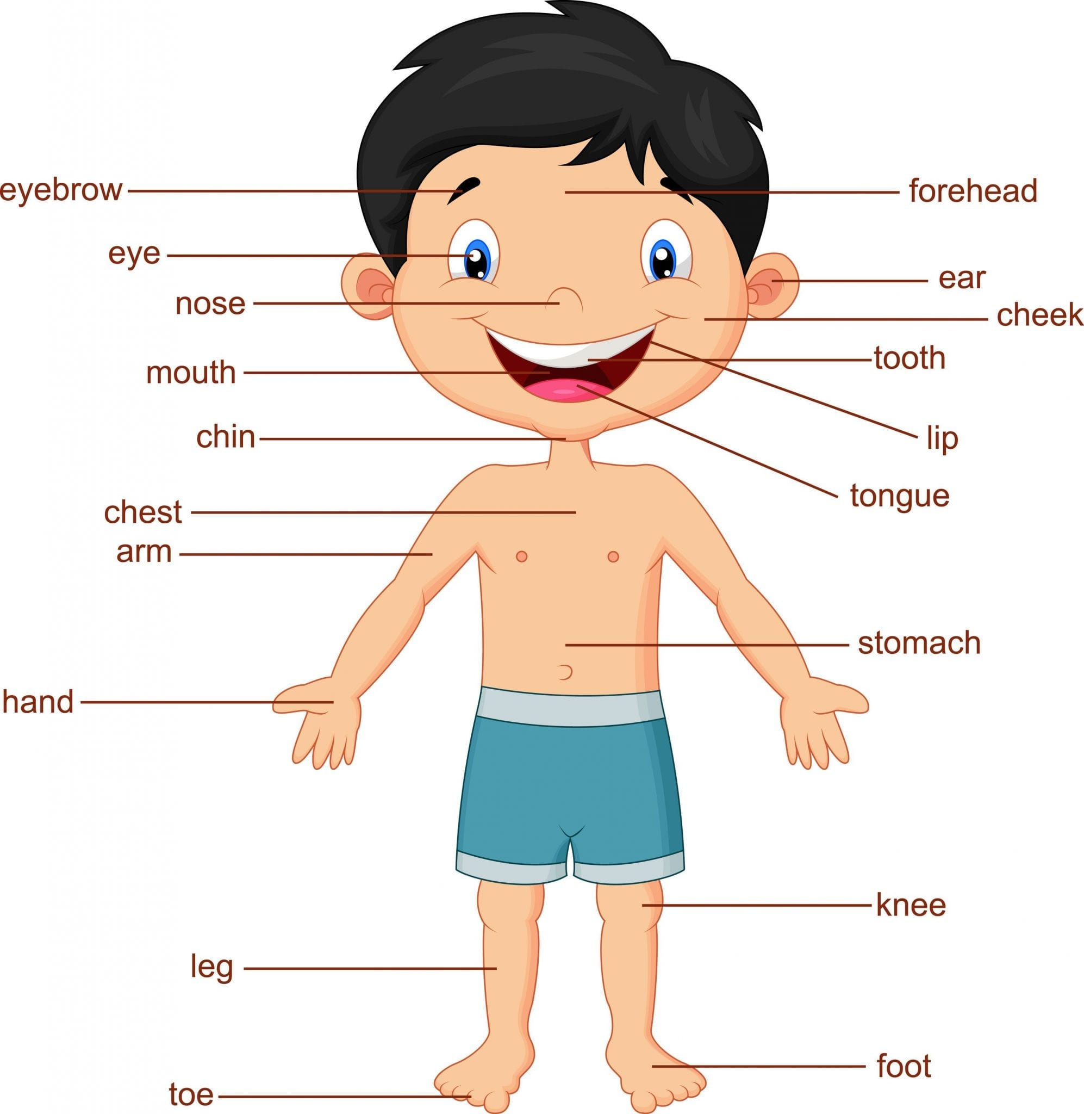

Slide 4


https://www.youtube.com/watch?v=QkHQ0CYwjaI https://www.youtube.com/watch?v=Rc_kIWKLiD8

