Slide 1
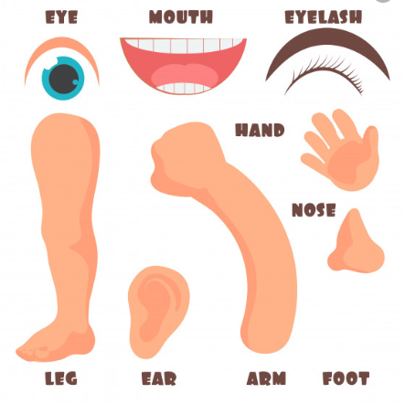

MY BODY

Slide 2
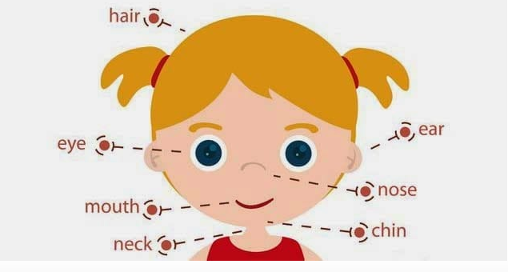

Slide 3
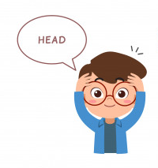






Slide 4
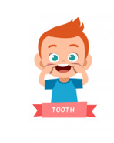





Slide 5


https://www.youtube.com/watch?v=3SjyEPhc-Tk
https://www.youtube.com/watch?v=6pLFxeumlpE

